Slide 1
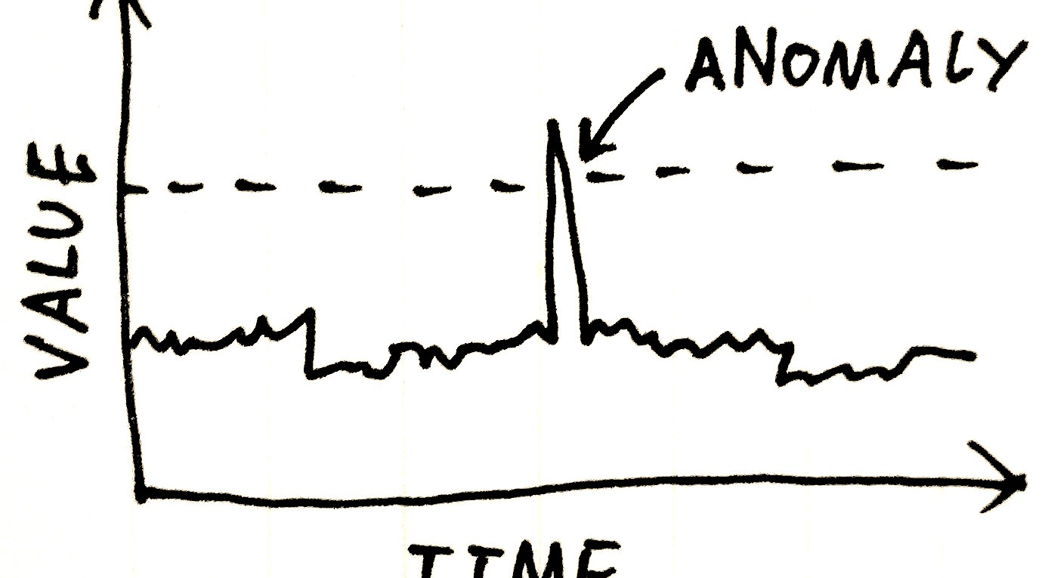
Yellow Planet Android Anomaly Detection
C:\>_
Hans Donkersloot, Geoff Friesen, Arthur Bulan

Slide 2
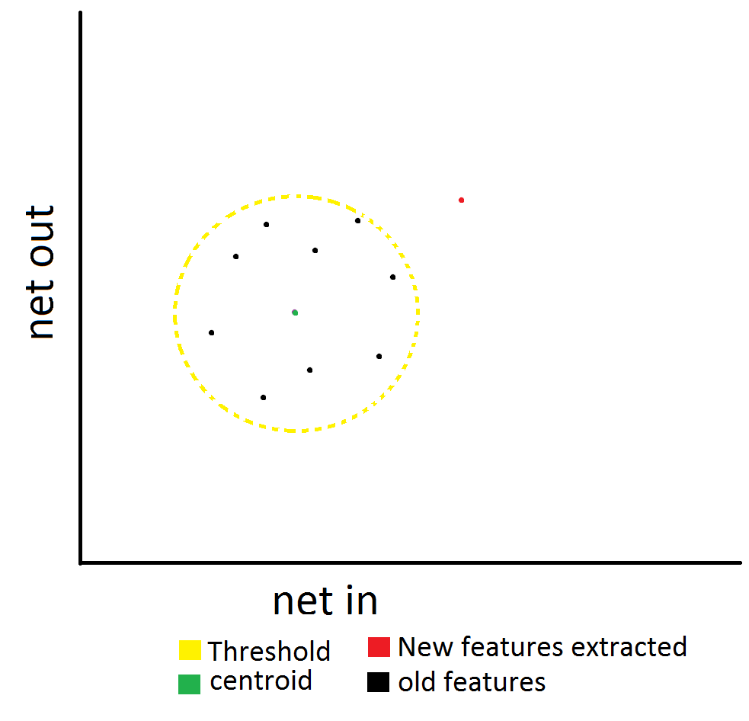
Anomaly Detection

Slide 3
The Problem
Detecting botnet-type activity in real-time on an Android device
Detecting power-draining attacks
Unauthorized resource usage

Slide 4
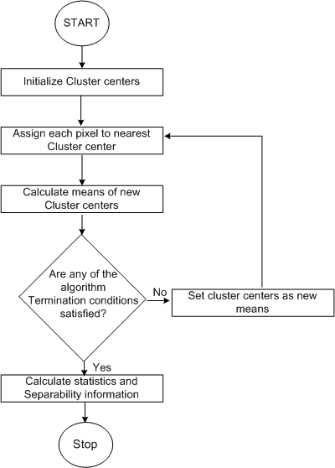
Related Work
Differences
Monitor enormous amounts of data
Static Profile
Similarities
Machine Learning
K-Means

Slide 5
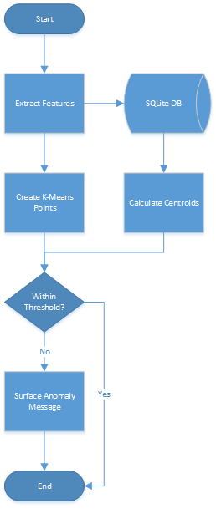
Overview

Slide 6
Feature Extraction
Extract features every 5 minutes
Query system files
Easily extensible

Slide 7
Features Collected
CPU idle time
Available RAM
Change in battery volts
Number of bytes transmitted
Number of bytes received

Slide 8
Feature Storage
SQLite database
Rolling set of data
Timestamp – Epoch time
Calculate time slice
Time Slice
5 minutes

Slide 9
Profile Creation
Evolving profile
Based on last 2 weeks of data
Takes first week of data non-anomalous

Slide 10
Anomaly Detection
Feature Pairs
CPU and Memory
Battery and Memory
Net in and Net out
K-Means
Use all data points to find centroid
Uses Euclidean distance
Threshold = 150% of centroid

Slide 11
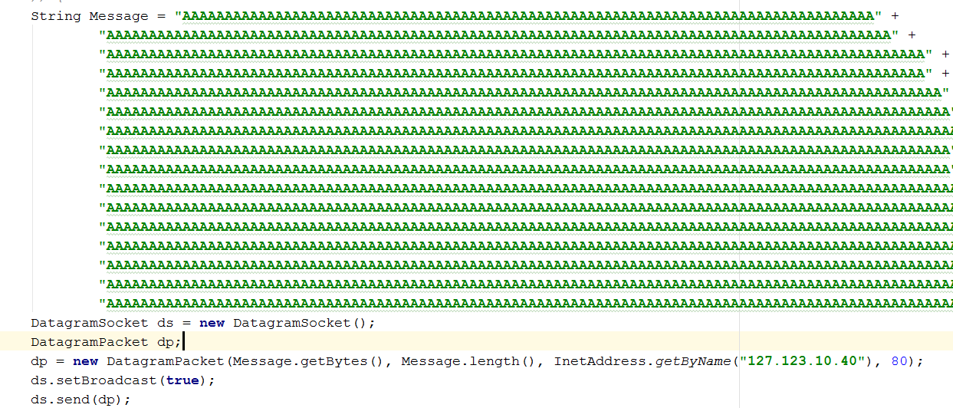
Testing
Simulated a week’s worth of data
1 day = 1 hour
1 time slice = 20 seconds
Simulated phone being used in DDoS attack

Slide 12
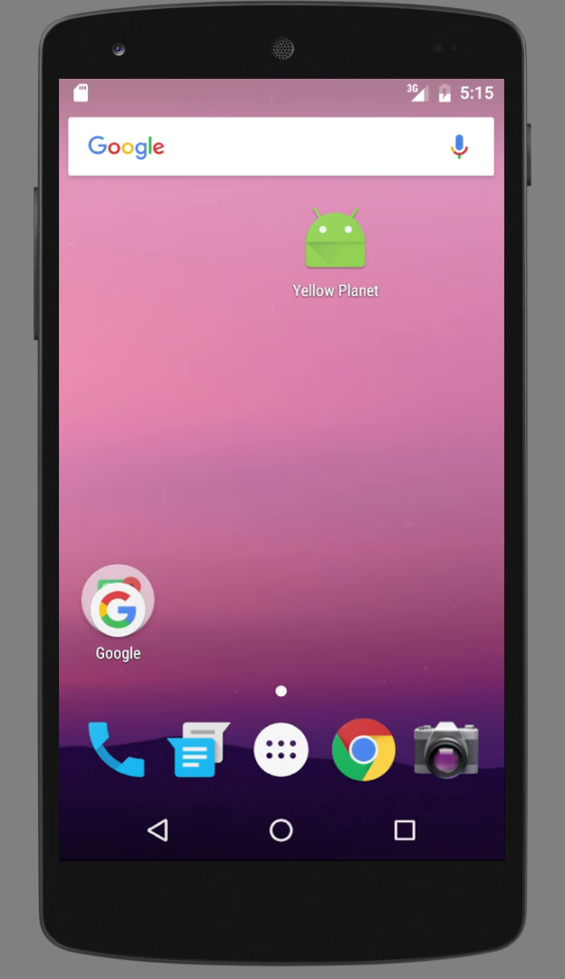
Demo

Slide 13
Testing Considerations…
Could take up to 5 minutes to surface a warning
Deviations from the centroid are very small
False positives?

Slide 14
Questions?

